Slide 1
Lab 3: Variability Due to the Measuring Instrument
Pre- lab

Slide 2
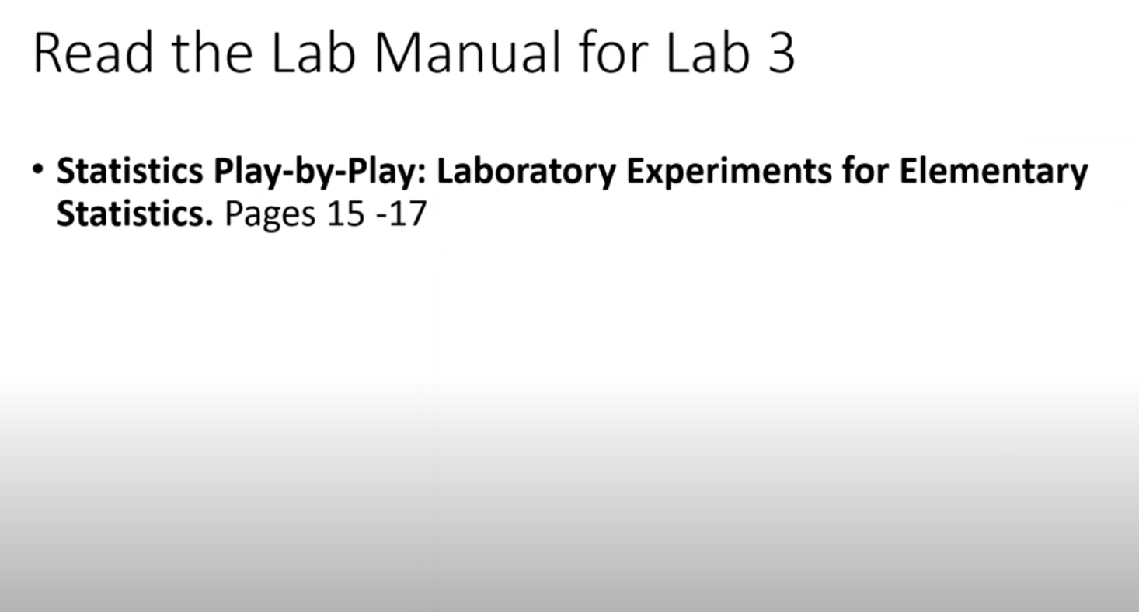

Slide 3
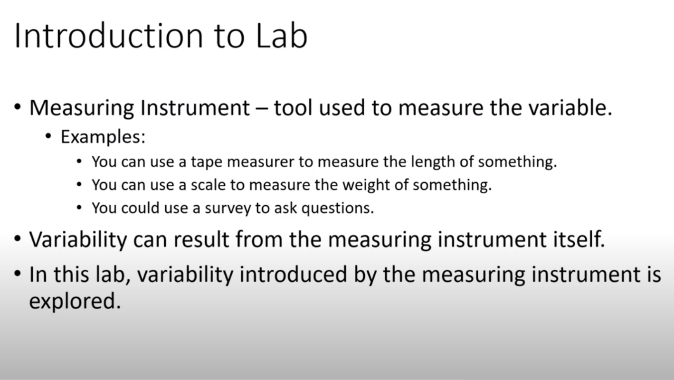

Slide 4
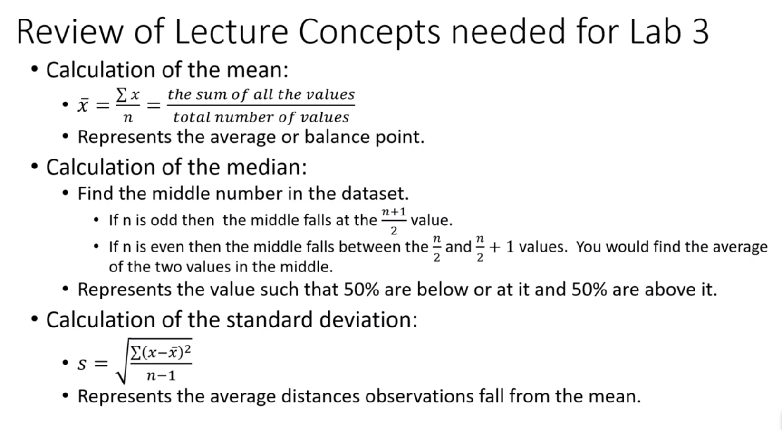

Slide 5
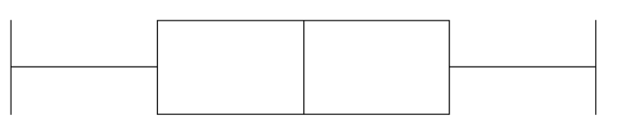
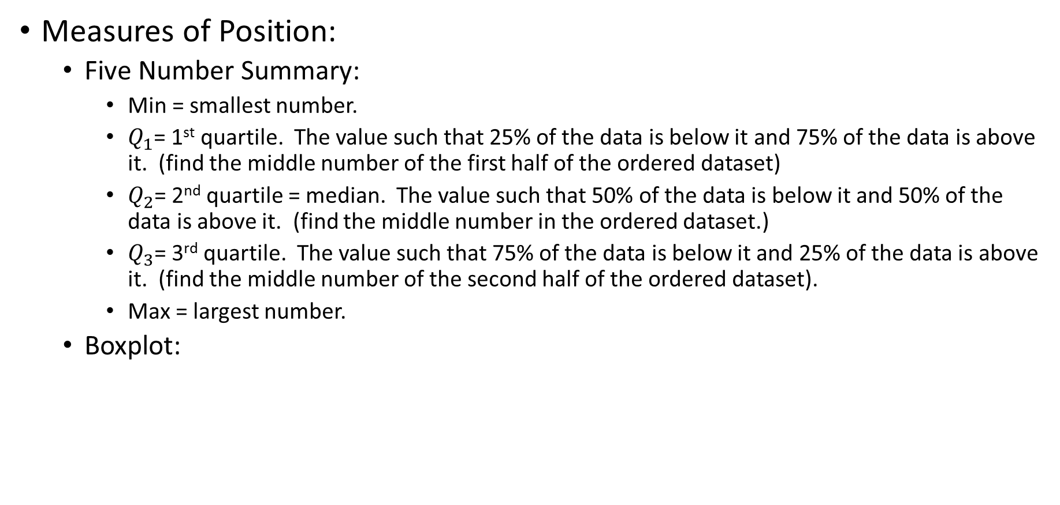



Concepts Needed for Lab 3
Measures of Position:
Five Number Summary:
Min = smallest number.
$Q_{1}$= 1st quartile. The value such that 25% of the data is below it and 75% of the data is above it. (find the middle number of the first half of the ordered dataset)
$Q_{2}$= 2nd quartile = median. The value such that 50% of the data is below it and 50% of the data is above it. (find the middle number in the ordered dataset.)
$Q_{3}$= 3rd quartile. The value such that 75% of the data is below it and 25% of the data is above it. (find the middle number of the second half of the ordered dataset).
Max = largest number.
Boxplot:
Min
$Q_{1}$
$Q_{2}$
$Q_{3}$
Max

Slide 6
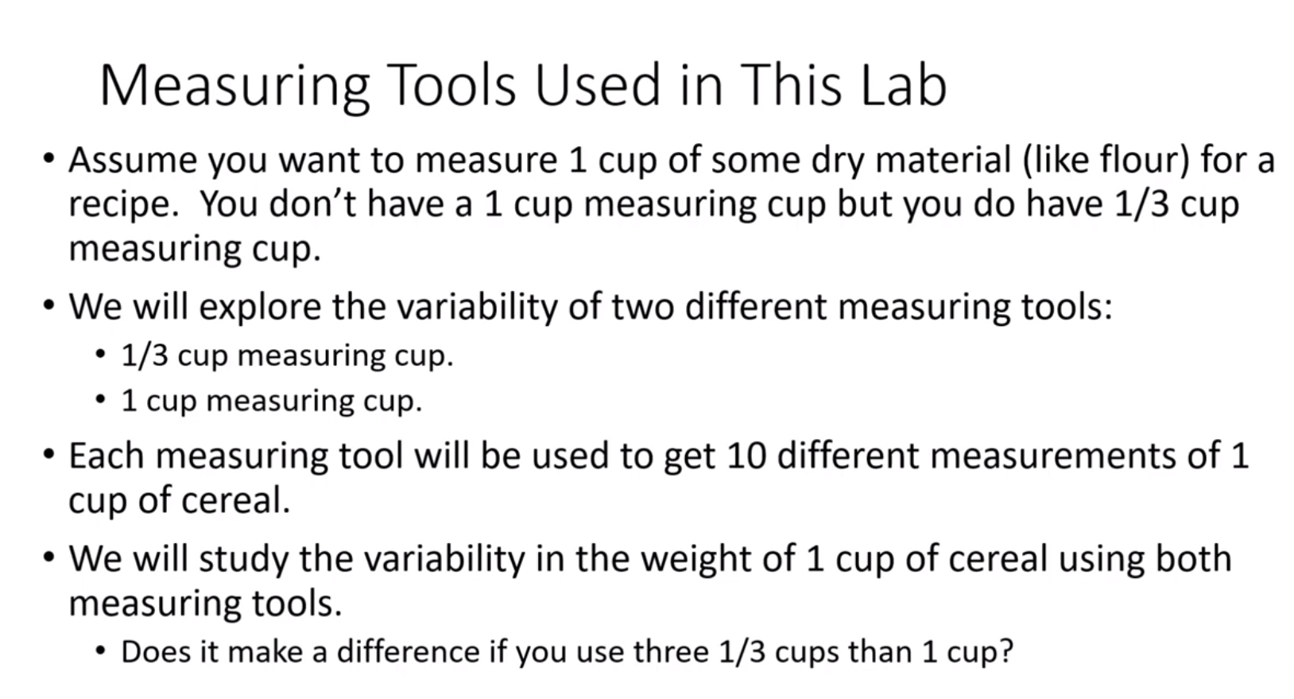

Slide 7
